Slide 1


Uscore2: How to conduct a Peer Review
Dr Kathryn Oldham OBE
Chief Resilience Officer
Greater Manchester

Slide 2
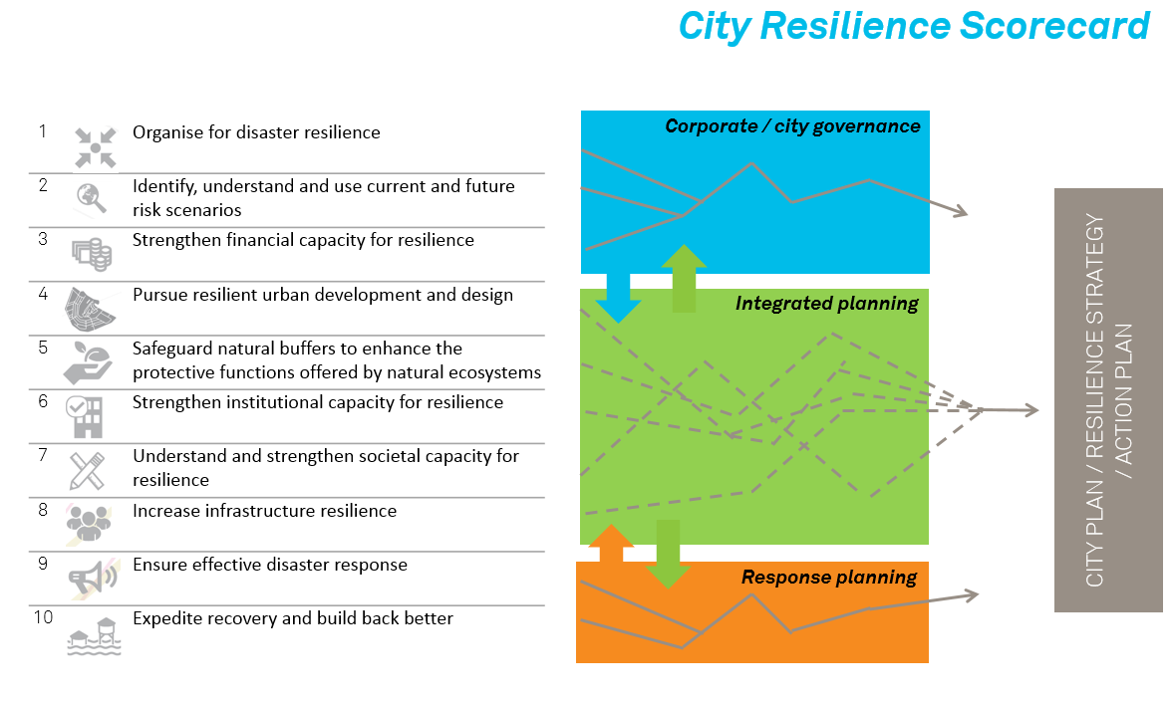
Making Cities Resilient: 10 Essentials

Slide 3
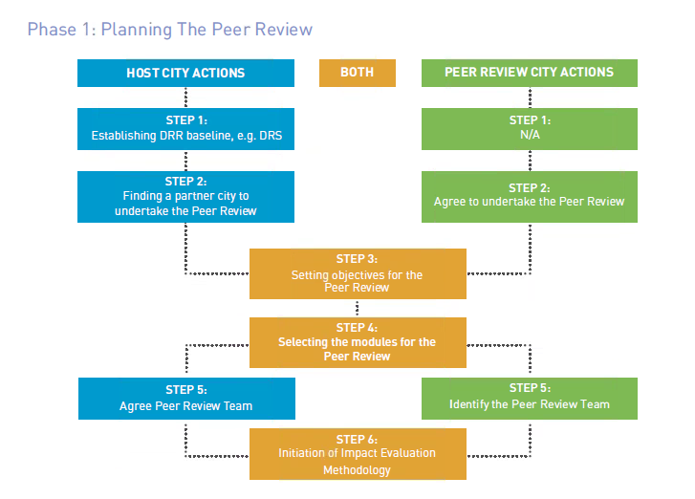

Slide 4
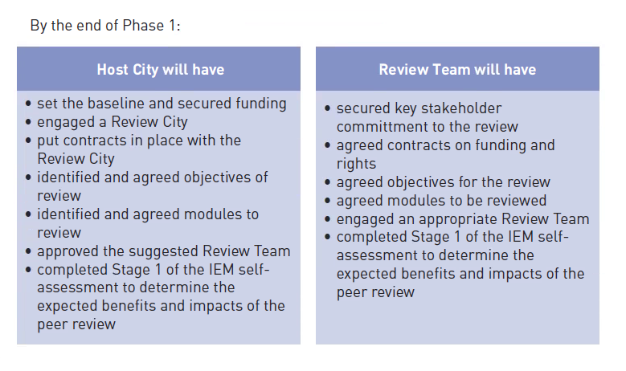

Slide 5
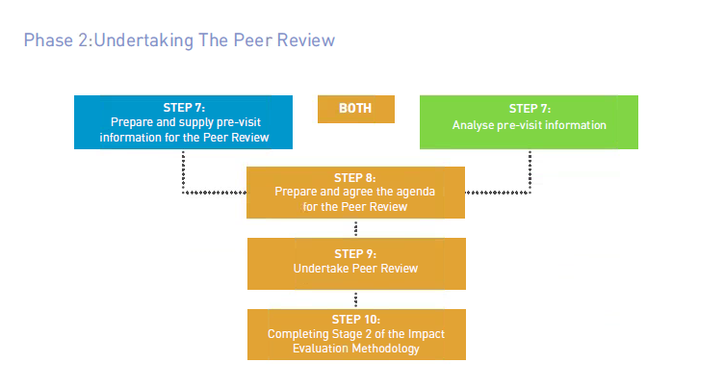

Slide 6
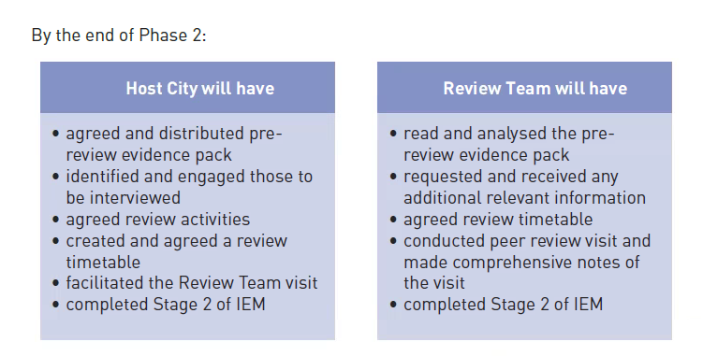

Slide 7
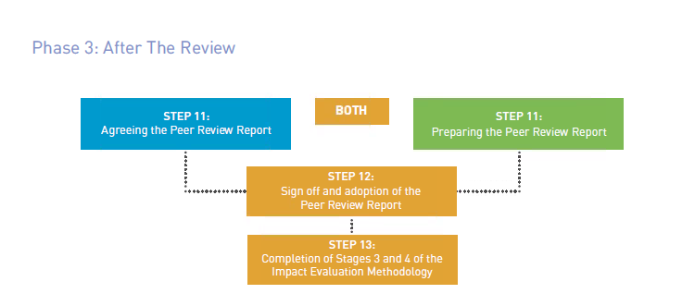

Slide 8
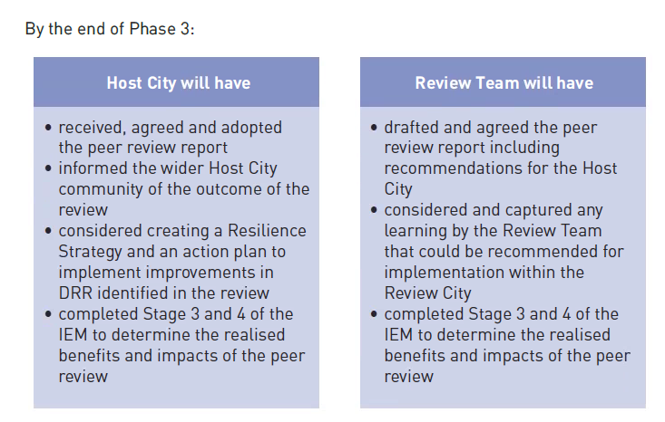

Slide 9
Peer reviews for cities: principles
Peer reviews are collaborative and about trying to find new solutions, not just confirming what cities already know
Peer reviews should be tailored to the city context: one size does not fit all and a focused peer review is perhaps more valuable than one that is too ambitious
City practitioners are involved in peer reviewing and being peer reviewed: there must be benefit to both teams
Working city to city can help with a route map to implementation, turning findings into actions
Cities have limited resources: this must represent value for money

